Slide 1

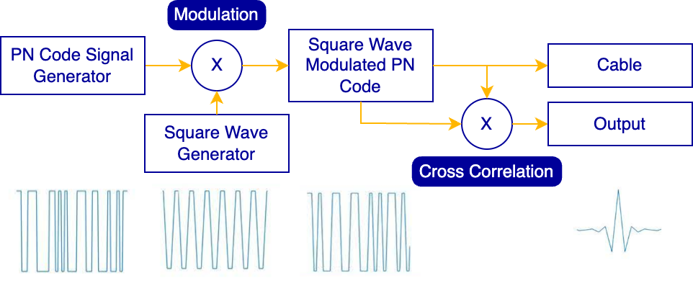
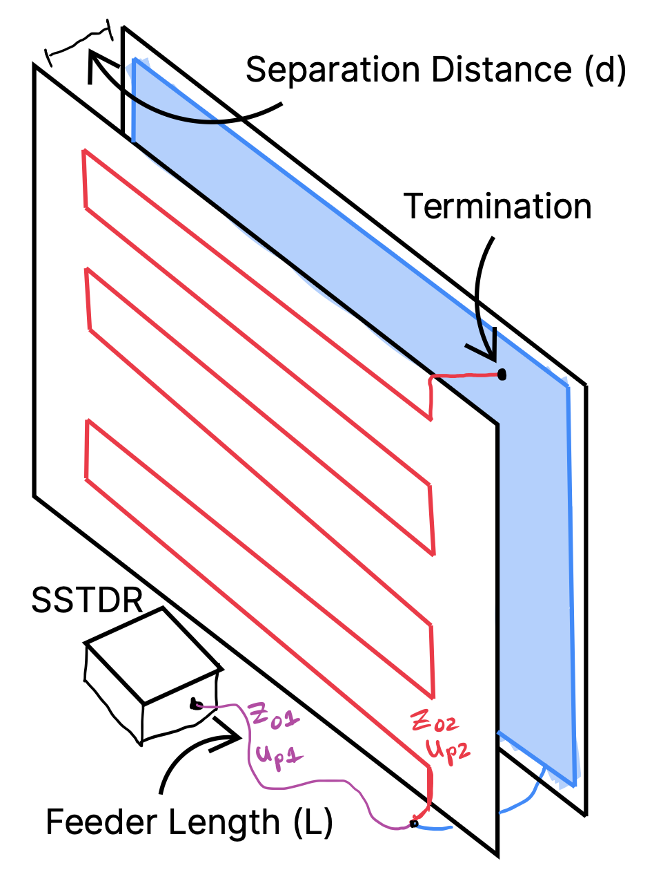
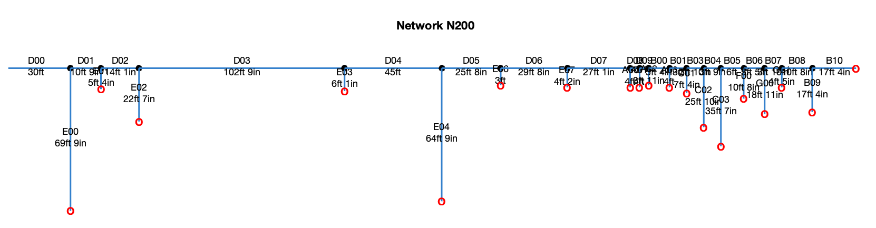
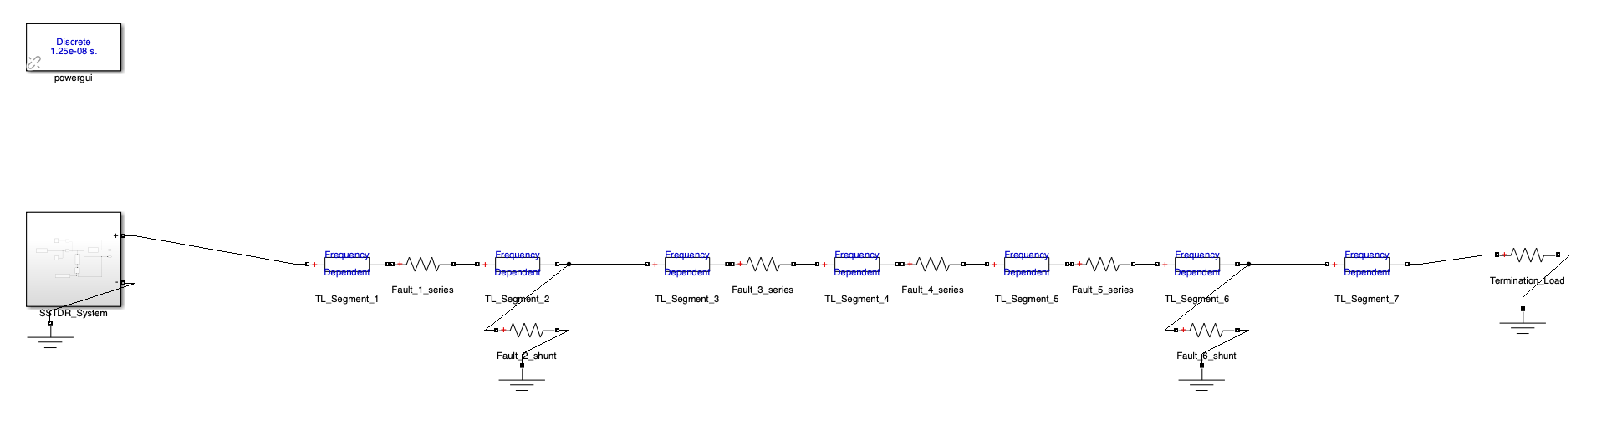
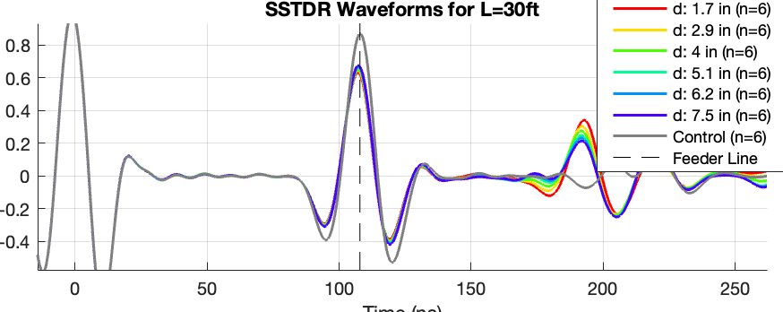
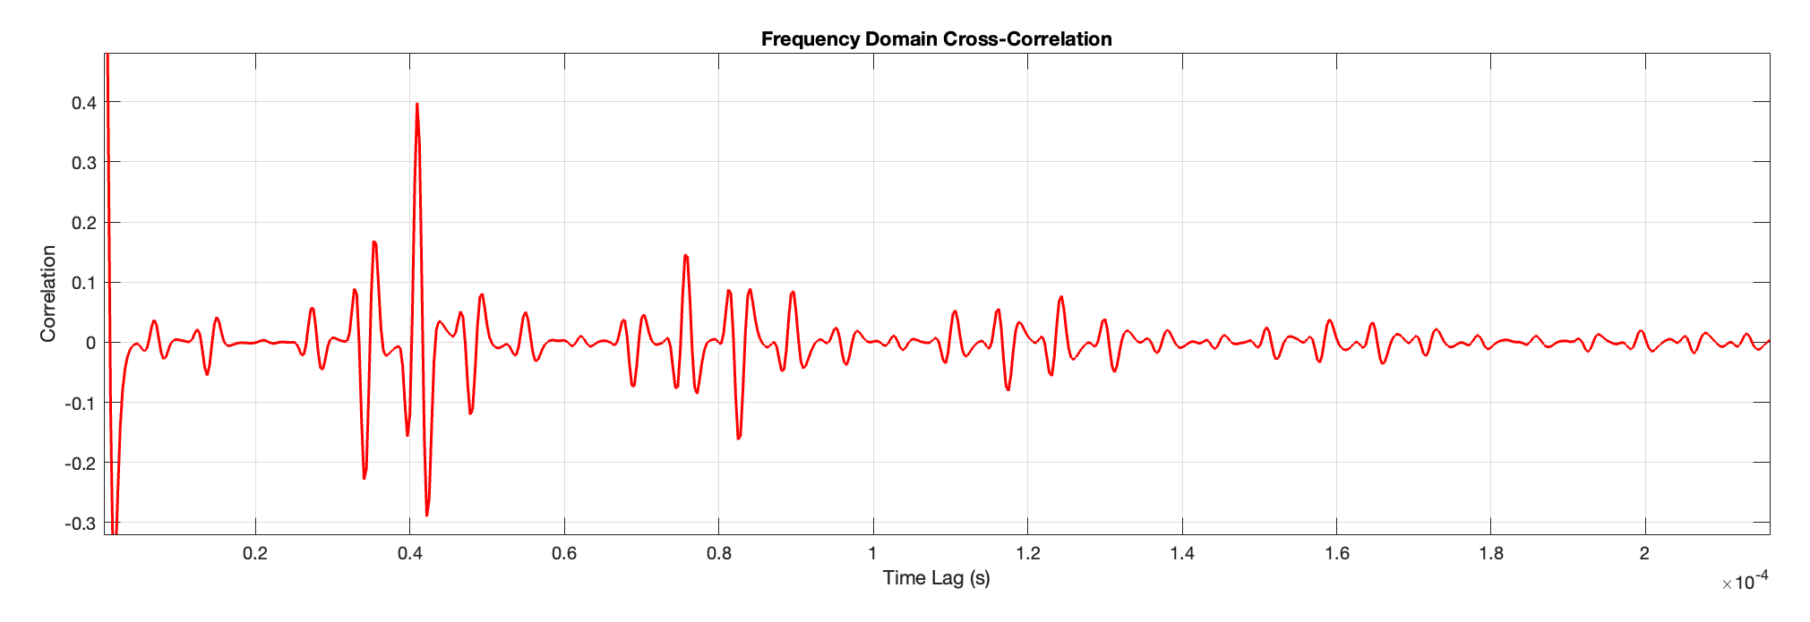
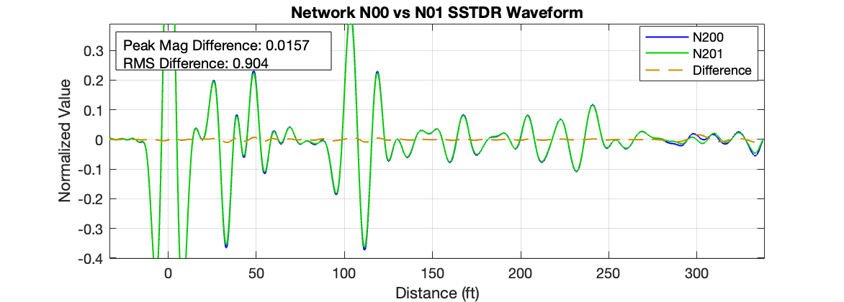
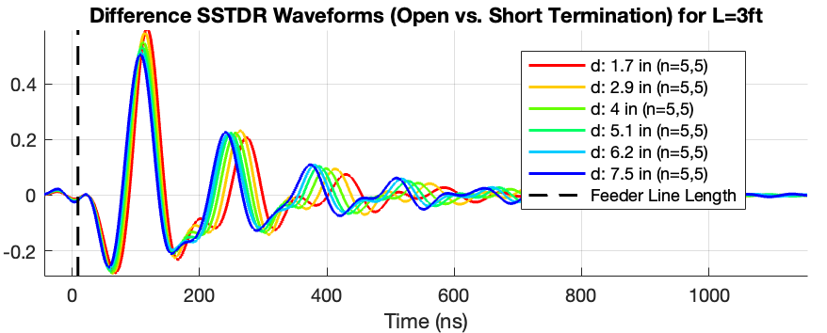
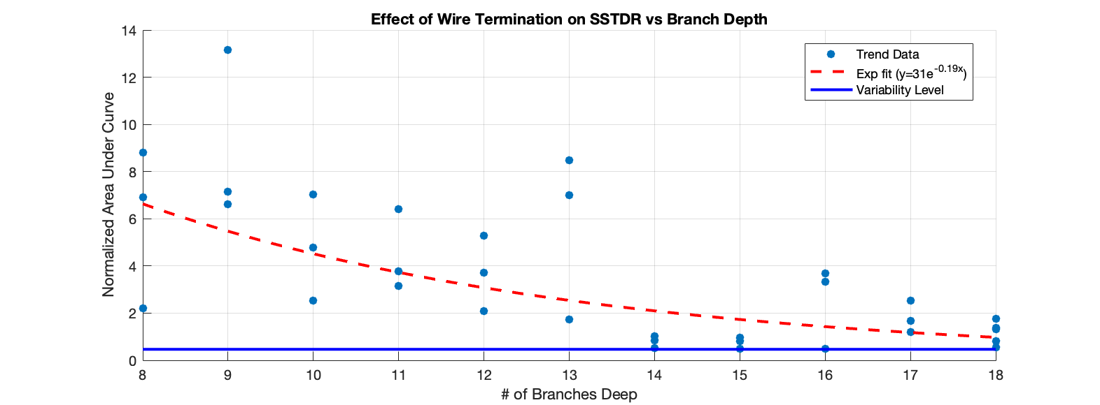


SSTDR for Fault Monitoring in Power Systems
Nathaniel Fargo, Ali Tasavvori, Cynthia Furse
University of Utah
s
Introduction to Spread Spectrum Time Domain Reflectometry (SSTDR)
SSTDR is a type of reflectometry that returns a correlation that indicates the reflection properties of the network.
Literature Review
SSTDR has been used in aircraft, rail, undersea
Furse et al, “Fault Diagnosis for Electrical Systems and Power Networks: A Review.” IEEE Sensors J, 2021
Methods of coupling SSTDR signals onto high-mid voltage lines
Glass et al, “Evaluation of Clamshell Current Coupler for Online FDR and SSTDR to Detect Anomalies in Energized Cables,” 2024
SSTDR has been used in branching networks before
Addad et al., "Analysis and Validation of SSTDR for Simultaneous Distributed Diagnosis of Wire Networks," IEEE Sensors J, 2025
Research Objectives
This work aims to establish the feasibility of a SSTDR fault detection mechanism in power distribution systems, which provides additional value in the case of de-energized systems.
Our research explores considerations (branching, transmission) and implementation decisions that could guide future work, as well as considering other power applications SSTDR, such as solar/wind.
Smith et al., “Analysis of SSTDR,” IEEE Sensors J 2005.
Signal Transmission
Methodology
Branching Networks
Methodology
We assembled BNC cable networks to simulate distribution lines. We then probed the network using SSTDR to produce a signature.
Taking the difference between signatures via RMS quantifies the detectable change between two networks. For example, terminating a branch with open vs short.
Data Generation for Machine Learning
Methodology
Turning SSTDR into fault location is difficult when there are multiple impedance changes and branches on the network.
Machine Learning is a promising approach to map these domains, but requires large amounts of data and proper architecture.
Main Findings
To measure changes in SSTDR responses due to coupling, we took measurements with the setup shown
We varied the feeder length and separation distance to and took 95% confidence intervals for the data.
Main Findings
Main Findings
Main Findings
Our system randomly generates network system and provides realistic simulation with full reflection and attenuation measures included.
Implications
This simulated training set should provide an estimate of the efficacy of neural network approaches and capabilities using very clean synthetic data.
Future Work
Using this data generation pipeline, we are entirely ready to start training a machine learning network.
Several architectures have been considered, including 1D convolution neural networks for the SSTDR waveform, paired with graph neural networks connecting a discretized version of the network layout and impedance faults.
Results demonstrate range of variability in both impedance and propagation velocity
Implications
These findings provide useful metrics for predicting types and measure of variability present in real distribution systems.
Uncertainty in propagation velocity and impedances reduce reliability of SSTDR.
Additional utility is found in other power systems, such as photovoltaics and lightning protection systems, where EM coupling can vary wildly.
LaFlamme et al., “Ground Faults in Photovoltaics: SSTDR for Characterization, Detection, and Location,” ASME 2022.
These charts point to detectable changes on cables at least 18 branches away in the network.
Implications
These findings were more promising than expected, pointing to SSTDR as a valid approach for diagnosing branching networks as well as single conductors.
Applications involve monitoring energized OR de-energized systems at the neighborhood level.
Disclosure
Dr. C.M. Furse is a co-founder of LiveWire Innovation/Viper Innovation which is commercializing SSTDR technology, and therefore she is disclosing a financial conflict of interest with this company.
Nathaniel Fargo
nathaniel.fargo@utah.edu
Dr. Furse EM Lab

